Slide 1
5.1 Mise en Place Putting Everything in Place
Professor Russell Smith
Centre for Entrepreneurship and Business Incubation, University of Malta
www.um.edu.mt/cebi

Slide 2
I-KNOW Curriculum: Track 5
The fifth ‘track’ of the curriculum describes business planning and cash flow forecasting

Slide 3
Mis en place
Quite literally, mis en place is a French culinary term that means ‘putting in place’ or ‘everything in its place’
The term relates to getting everything set up prior to service in a professional kitchen: meats all cut up, vegetables prepared, sauces made etc
Many top chefs think of this more as a state of mind... the discipline to plan and prepare all you can think of ahead of starting a service
We think that business planning is like that...

Slide 4
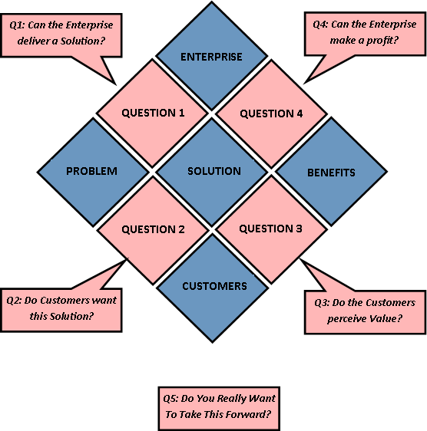
Starting to get things ready
The GERMINATOR sequence:
Use the GERMINATOR sequence prior to any planning process. The model follows the Problem / Solution (Product or Service) / Benefits sequence and there are five key questions:
Can the Enterprise deliver the solution?
Do Customers want the solution?
Do Customers perceive value?
Can the Enterprise make a profit?
And if all are answered ‘yes’... do the Founders want to do it?

Slide 5
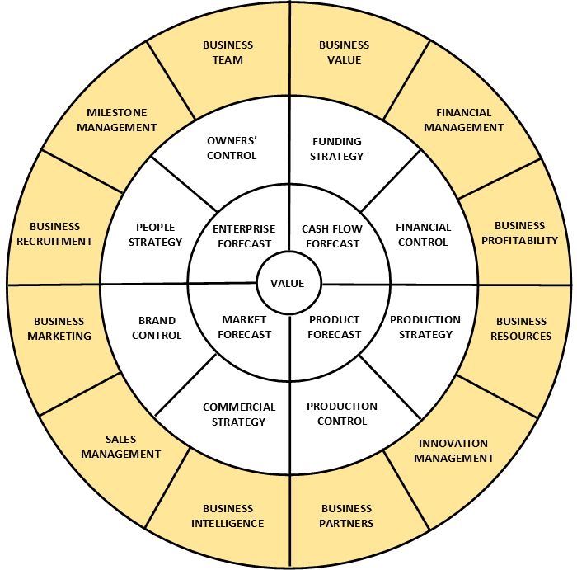
Putting things in place
The Incumatrix™ model uses a simple illustration of ‘Enterprise Anatomy’
By collecting information and creating plans related to the 25 components it is possible to consider the development of a business plan in a systematic manner
The same approach can be taken for commercial or social enterprises
Copyright Samarkand Management Ltd. Reproduced with permission.

Slide 6
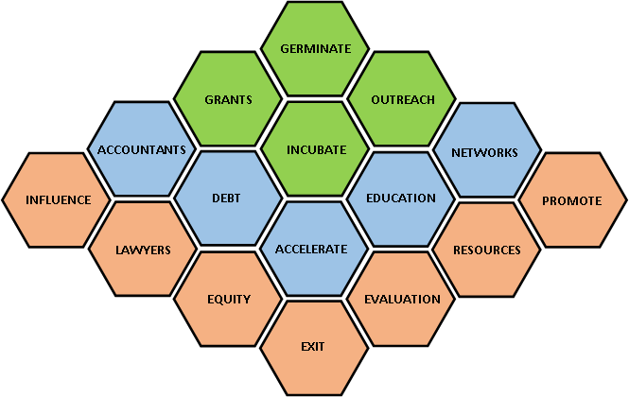
Are things in place externally?
This is the basic form of Enterprise Support Infrastructure
Key vertical (in the centre) is the Progress Pathway in which enterprises are Germinated, Incubated and Accelerated followed by Exit
To move through the Progress Pathway efficiently, Founder(s) should identify what and who to access from the other columns
Get this done as part of early business planning... not just before you launch!

Slide 7
Starting to start...
National surveys show that around one in ten adults would like to be their own boss. But just how easy is it to quit your job and start your own business? Actually it’s very easy. What’s difficult is making a new business sustainable since more than half fail within three years. However, those that fail often do so because of poor planning.
It’s a really bad idea to just quit your job and then start a business. Much better to start your own business first and then quit your job. But this doesn’t mean that you have to start trading… planning is an essential part of enterprise and this is where you should start.

Slide 8
‘Plan hard, work easy’
The Armed Forces have a motto: “Train hard, fight easy.” In business that translates as: “Plan hard, work easy.”
A simple, three-step approach to the business planning process helps.
Step one is to plan exactly what you are going to sell.
Step two is to calculate what it will cost to make the product or to deliver the service.
Step three is to do market research in order to ensure that you will be able to sell enough products and/or services to cover all costs.
If your plans forecast that you can make a profit then, quite literally, you are in business. If not, then you need to think of a new plan. People that can do this are called entrepreneurs. People that can’t are called employees.

Slide 9
Step One
In truth, step one is down to you - it’s your business and you can sell what you want. Remember that there are only two things that your business can sell: a product or a service.
Think also about how and why people will buy from you. And so consider the place where they will buy (from a shop or via the internet), the price at which they will buy (cut-price or “luxury”) and the promotion needed to get them to buy (your marketing plan).

Slide 10
Step Two
Get help from an accountant. All businesses need one. These professional advisers are not just there to fill in tax returns – they can be of most use to you in your planning phase since they will think of things that you will not.
If funds don’t permit the use of a professional adviser then visit a high street bank to get their business start-up pack. These guides usually include a budget spreadsheet that will help you to forecast costs. The spreadsheets are also used to illustrate the need for any start-up funds.
Make sure that you include a reasonable salary for yourself as many business owners fool themselves into thinking that their business is viable by drawing too little.

Slide 11
Step Three
Step three is where you calculate what sales you will need in order to generate a profit. This is where many people come unstuck: either by being optimistic about sales or by failing to charge enough.
Objective market research will allow you to estimate what customers are prepared to pay. Measure yourself against local competitors – how can you make your products or services better than theirs?
But don’t be afraid of competition as it shows there is a market for what you propose to sell.

Slide 12
End of Presentation
Thank you for your attention
Any questions?

